Slide 1

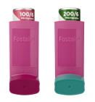
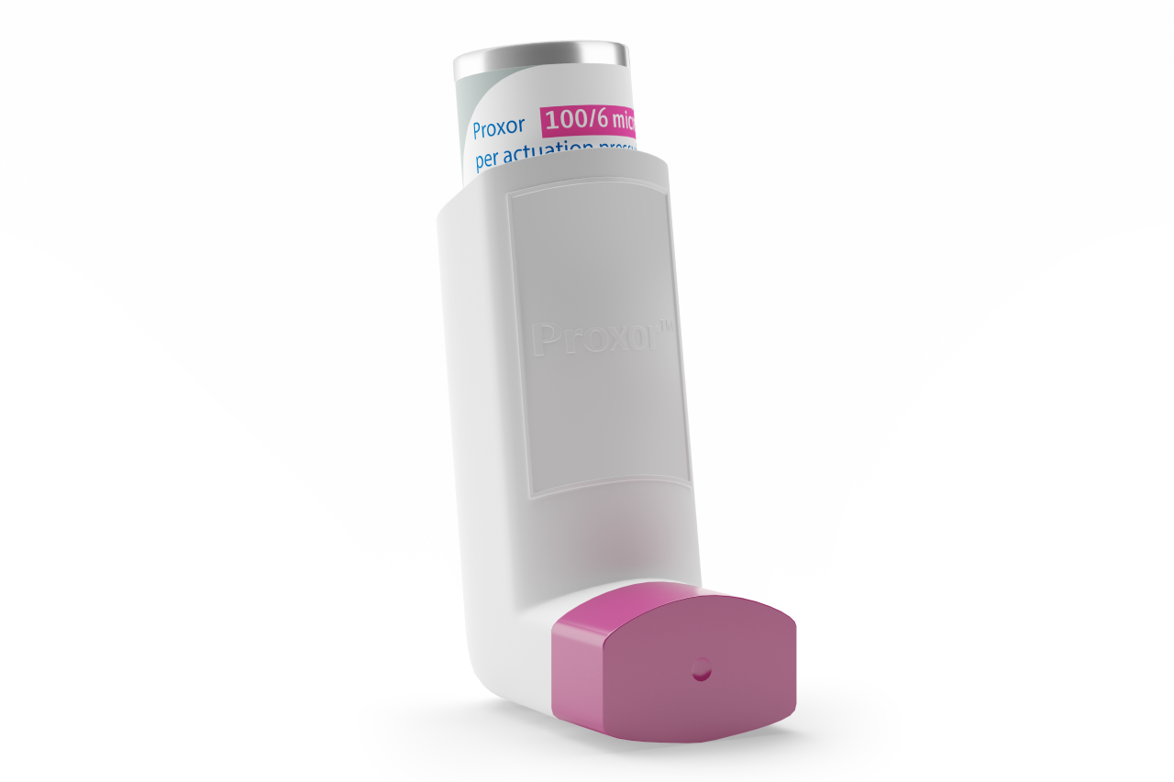
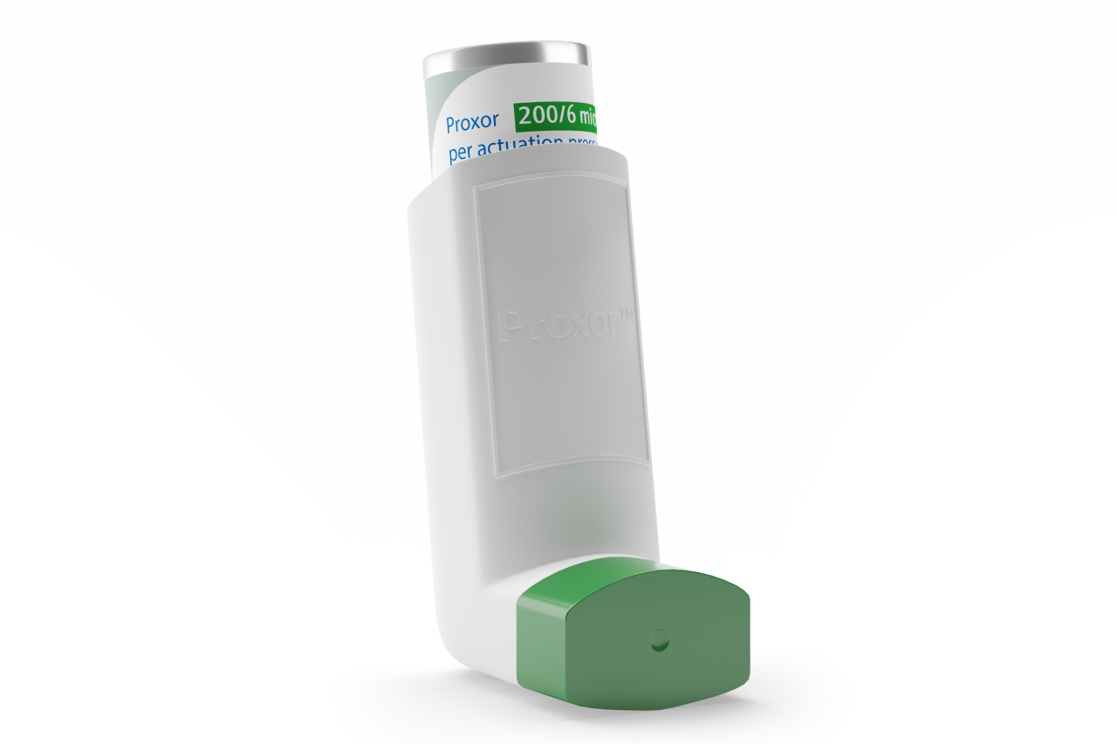
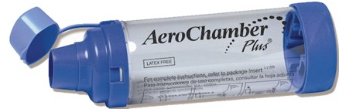

INSERT PRACTICE LOGO
Changing your Fostair® Inhaler to Proxor®
Your Fostair® inhaler will look a little different when you pick up your next prescription.
This change is nothing to worry about because the new inhaler has the same medicines in it.
Proxor® also has formoterol and beclometasone in it and how you use it won't change. You will need to carry on using the same number of puffs a day.
If you use a spacer, the AeroChamber Plus® is recommended.
If you feel you are getting worse once you are using your Proxor® inhaler please call your healthcare professional for an urgent appointment.
Please take used inhalers to a pharmacy.
Review Date: December 2026

