Slide 1

Medicines Optimisation Strategy
2024 - 2029
Notes:
=

Slide 2
Contents
Foreword 3
Introduction 4-5
What is Medicines Optimisation?
  The Case and Opportunity for Change
Our Shared Purpose 6
What’s Important for People and our Health And Care System 7-9
What Medicines Optimisation Means For Person Centred Care 10
Delivery of our Shared Purpose through our Strategic Aims and Key Enablers 11
Key Principles to Guide our Work 12
Key Enablers to Help Deliver this Work 13
Our Improvement Plan 14-15
How Will We Measure Success And Monitor Improvement? 16
Case Studies 17-19
Thank you 20
Glossary 21
Appendices 22-26

Slide 3
Foreword
We are proud to introduce our first Medicines Optimisation Strategy for our Integrated Care System.
We want to raise the profile of medicines optimisation and make medicines optimisation everyone’s business.
Medicines are the most widely used intervention in health and hence medicines optimisation – getting the right medicine to the right person at the right time – is key to optimising the health of our population and maximising our resources.
Our strategy sets our long-term ambition, purpose and aims for the next 5 years. The document has a system focus and is complemented by organisational medicines optimisation strategies and aligned to our ICS Strategy.
This strategy has been developed through large scale engagement, hearing what matters to local people and health and care professionals. Implementation will be phased and supported by a robust delivery plan agreed by the system each year.
Our approach is to scale and spread what works, address gaps and support people to improve, innovate and transform the way we optimise the use of medicines.
We have presented our strategy in a simple format but acknowledge the complexity and ambiguity people are working in - some of our work will be focused on simplifying processes to make it easy for people to do the right things.
Delivery of this strategy extends beyond pharmacy professionals. It will require a culture change in the way our health and care teams and local people work together This collaboration will enable medicines optimisation that is joined up, person centred and holistic and delivers the best outcomes for our local people and the wider health and care system.
Mindy Bassi
Chief Pharmacist
Dave Briggs
Medical Director
Rosa Waddingham
Chief Nurse
Nottingham and Nottinghamshire Integrated Care Board

Slide 4
Our definition
Introduction –
What is Medicines Optimisation?
Medicines optimisation looks at the value which medicines deliver, making sure they are clinically and cost effective, so that they deliver the best outcomes for people, and the wider health and care system.

Slide 5
Introduction –
The Case and Opportunity for Change
Medicines are the most common health intervention in the world – Approximately half of all UK adults take at least one prescribed medicine
Medicines deliver extensive health benefits but have the potential to cause harm
30- 50% of the medicines prescribed for long-term conditions are not being taken as intended
Medicines contribute 25% of the carbon footprint associated with the NHS
Between 5-10% of all hospital admissions are medicines related, of these admissions, around two-thirds are preventable
National drive for health and care professionals to take on more/advanced clinical roles and an increasing number of non-medical prescribers
= Opportunity to improve health outcomes, reduce costs, waste and reduce inequalities across our system

Slide 6

Our Shared Purpose
To ensure all medicines have value and provide the best outcomes for all people
Co-produced with My Life Choices, a group of local people who use NHS and Social Care Services

Slide 7

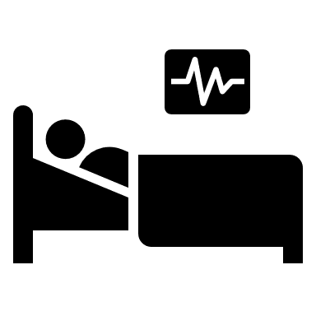



What’s Important for People and Our Health and Care System?
Throughout the engagement undertaken with health and care professionals and local people, we heard that people wanted to focus on;
Patient outcomes - understanding the value of care rather than the cost of medicines
Waste reduction - rather than cost reduction
Person Centred Care - a focus on what matters to people

Slide 8
Themes We Heard About People
De-medicalisation – evidence based alternative therapeutic interventions and care pathways
Effective and safe use of medicines to improve outcomes – reducing inappropriate polypharmacy
Seamless and consistent care
Accessible provision – closer to home
Shared Decision Making: providing accessible, tailored and consistent information so people have control and can make informed choices in partnership with healthcare professionals
Supported Self Management: increase the knowledge, skills and confidence people have to manage their own health. Develop consistent tools and approaches to support people with this.
Personalised Care - a focus on what matters to people
ICS Strategy guiding principles
1. Prevention is better than cure 2. Equity in everything 3. Integration by default

Slide 9
Themes We Heard About Our System
Services focused on greatest and specific needs - deprivation, hard to reach groups under represented/easily ignored and people with multiple disadvantage, ageing population, people with mental health needs and long-term conditions
Medicines safety – use of high risk medicines, antimicrobial prescribing, learning from incidents and reducing variation in prescribing
Environmental sustainability and the green agenda
Cost effective and value based use of medicines
Inform, educate and challenge myths and expectations about prescribing and medicines
Doing things once and consistently for our population - for example, medicines information and access to advice, policies and guidance
ICS Strategy guiding principles
1. Prevention is better than cure 2. Equity in everything 3. Integration by default

Slide 10

What Medicines Optimisation Means for Person Centred Care
Starting medicine
Dose adjustment
Stopping medicine
The optimal use of medicines includes the entire prescribing spectrum including starting, dose adjustment and stopping at the point at which harm outweighs benefit.
How health and social care professionals work together to provide person centred care
Help and support in taking medicines
  Accessible, consistent information about evidence-based treatment options to enable a personalised shared decision about the most appropriate therapy
  Effective and safe use of medicines to improve outcomes
  Reduce inappropriate polypharmacy
Wider determinants
of health
Other Therapies
  Availability of medicines
  Accessible, clear and consistent information in appropriate language to enable personalised care, shared decision making and supported self management
  Clarity about where to go for advice if needed -access to pharmacy teams to support people in taking medicines effectively and to manage side effects
  Regular reviews of medicines between patients and clinicians
  Accessible, consistent information to enable personalised care by shared decision making about deprescribing, if appropriate
  Consideration of alternative evidence based therapeutic interventions
  i.e. -green social prescribing, holistic therapies
  Lifestyle
  Activities we can do to prevent becoming unwell
  i.e. eating well and exercising regularly, not smoking, getting good sleep, resting, vaccinations
Decision to take medicine
Regular reviews of medicines
Prevention
Diagnosis
System
Services focused on specific needs. Reduce unwarranted variation in prescribing.
Accessible provision, closer to home
Medicines safety – system focus on reducing harms from medicines, embed learning from incidents. Antimicrobial stewardship.
Cost effective use of medicines. Focus on waste reduction, environmental sustainability and overall cost of care
Do things well once and provide consistent care for our population

Slide 11
Delivery of our Shared Purpose through our Strategic Aims and Key Enablers
Strategic Aims
Guided by our Principles
Person centred care
Population Health Management
Improvement and Innovation
Research
System working
Medicines are clinically effective and prescribed safely
Shared Purpose
To ensure all medicines have value and provide the best outcomes for all people
Medicines are equitably accessible across our ICS
Pharmaceutical Care is joined up across our ICS; locally agreed information is shared
Medicines waste is reduced and sustainability is promoted
System value from medicines is achieved
Key Enablers
Digitalisation and technology
Workforce Development
Policy, Guidance and Legislation

Slide 12
Key Principles to Guide our Work
These are the lenses we will use to approach our strategic changes
1 - Person centred care
Empower patients through shared decision making and self-management support, guided by and using the ‘It’s ok to ask’ approach and resources.
2 - Population Health Management
Use of data and intelligence to develop services and interventions to reduce health inequality, focusing on greatest and specific needs.
3 - Improvement and Innovation
Application of improvement methodology to prototype, test, scale and spread new ideas and solve problems in clinical processes, creating spaces for people to learn together. Harnessing the power of Experts By Experience through co-production to ensure our approach focusses on the needs of our local populations.
4 – Research
Undertake research to build evidence to underpin new approaches and practices.
5 - Systems Working
Further connect, collaborate, learn and work with system stakeholders and our population
Notes:
Environmental sustainability and waste removed from principles and included as a strategic aim

Slide 13
Key Enablers to Help Deliver this Work
1 - Digitalisation and Technology
Work in partnership with Digital Notts to help to develop the Shared Care Record to provide accurate and visible medicines records. Exploit opportunities to enable interoperability between systems. Exploring new digital innovations for example in robotics, AI, wearable devices and automation.
2 – Workforce Development
Improve recruitment, retention and professional development of our workforce, recognising the role of the whole multidisciplinary team in medicines optimisation
Enable health and care professionals to work to their full scope of practice, develop and grow our non-medical prescribers (including Pharmacists qualifying as prescribers from 2026) to increase access to and consistency of prescribing , expand advanced practice and evolve supportive roles to enable professionals to work to the ‘top of their licence’
Develop and enable ‘portfolio careers’ through partnership and ensure our teams have an understanding of the entire patient pathway through joint education and training for multi-disciplinary, multi-agency teams so that they can confidently and competently support shared decision making and a person-centred approach to medicines optimisation.
3 –Policy , Guidance and Legislation
Changes in legislation present opportunities to work differently, we will assess how this could improve Pharmacy services for our population. Take direction from National Policy and Guidance in our planning.
Notes:
Removed Communication and Campaigns as they are part of the system working principle

Slide 14
Our Improvement Plan
Strategic Aim
Objective
Outcome
Medicines are clinically effective and prescribed safely
Implement data driven systematic structured medication reviews for patients taking multiple medicines
Inappropriate Polypharmacy is reduced
Increase learning and sharing from medicines safety related incidents to reduce preventable harm from medicines
Preventable harm from medicines is reduced
Implement data driven systematic structured medication reviews for patients taking high-risk medicines.
Develop decision making tools with Experts by Experience focused on supporting patients to take their medicines safely and participate in decisions about their care
People are empowered to manage their own health and take their medicines safely, improving their health outcomes
Pharmaceutical Care is joined up across our ICS; locally agreed information is shared
  Strengthen use of, and prescribing decisions adherence to the joint formulary
Improve access to and understanding of guidelines and formularies through standardised and single point of access to medicines information across care pathways for prescribers and patients
Unwarranted variation in prescribing is reduced
  Improve consistency in adoption of shared care protocols across the ICS
Improve medicines optimisation around transfers of care
Reduction in medicines related readmissions

Slide 15
Our Improvement Plan
Strategic Aim
Objective
Outcome
Medicines waste is reduced, and sustainability is promoted
Identify potential areas of medicines waste across our system and work to reduce this
Reduced medicines waste
Work with Patient Groups, Primary Care Practices and Community Pharmacies and Digital Notts to help people to ‘Only Order what they need’
Reduction in carbon footprint of medicines
Work with the Greener Programme to recommend medicines with the lowest carbon footprint within formularies and guidance where clinically appropriate
Medicines are equitably accessible across our ICS
Increase provision of community pharmacy clinical services to improve access to medicines
Improved and equitable access to medicines
Scope further provision of specialist pharmaceutical care closer to home
  Implement consistency of communication with professionals, patients and carers, to manage access to medicines in short supply
System approach to managing medicines shortages
System value from medicines is achieved
System: Strengthen MOPB governance and accountability to maximise medicines value
Optimised health outcomes from the expenditure on medicines
Place: Robust prescribing processes and responsibility to maximise medicines value
Person: Work with Experts by Experience to increase the knowledge, skills and confidence people have to manage their own health and their medicines

Slide 16
How Will We Measure Success?
By implementing plans to deliver this strategy we expect to see improvements in the following outcomes;
Medicines are clinically effective and prescribed safely
Pharmaceutical Care is joined up across our ICS; locally agreed information is shared
Inappropriate Polypharmacy is reduced
Preventable harm from medicines is reduced
People are empowered to manage their own health and take their medicines safely, improving their health outcomes
Unwarranted variation in prescribing is reduced
Reduction in medicines related readmissions
Medicines waste is reduced, and sustainability is promoted
System value from medicines is achieved
Medicines are equitably accessible across our ICS
Reduction in carbon footprint of medicines
Reduced medicines waste
Optimised health outcomes from the expenditure on medicines
System approach to managing medicines shortages
Improved and equitable access to medicines

Slide 17
Case Studies
Making optimal use of medicines really makes a difference to people’s lives;
I worked with a patient who was taking a lot of medicines, we worked together to safely remove some medicines.
The results were that he went from never leaving his house to taking a short walk with his dog, he said his pain was 70% improved.
PCN Pharmacist, Nottingham City
Pharmacy First
‘I had to pick my daughter up from school due to a sore throat with a fever. I was able to walk into a pharmacy and after a short wait was seen by the pharmacist who was able to provide treatment for the sore throat under a patient group directive. The pharmacist was really good with my daughter, explaining everything to her.
My daughter was able to go back to school the next day and this was much easier than ringing to try and get a doctor’s appointment’
Rachael

Slide 18
Case Studies
Utilising the full potential of Pharmacists and Pharmacy Technicians within general practice.
The Pharmacy Prevention Service for Hypertension is a specialised clinical pharmacy team who help to screen, diagnose and manage hypertensive patients across 12 practices in Nottingham providing a standardised level of care.
In the first year 312 patients were newly diagnosed with hypertension which we know is already starting to prevent heart attacks and strokes for people living in this area.
  “As a GP within Nottingham West PCN I have thoroughly welcomed this initiative at a time when capacity is such an important issue for primary care.
  The team have demonstrated that they can safely and proactively manage these patients to high clinical standards on behalf of 12 practices.
  The capacity this team have released in general practices has the potential to help transform how primary care is delivered in future.”​
  Professor of Primary Health Care Tony Avery

Slide 19
Case Studies
Community Pharmacies and Local GP Practices Working Together to Provide Access to Medicines
A patient receiving palliative care for a fungating tumour needed a special-order pain relief medicine.
The PCN Pharmacist contacted the pharmacy who went above and beyond to obtain the product at the best value to the NHS and delivered to the patient free of charge as the family did not drive.
This made a huge difference to the patient and their family as the medicines helped to reduce the patient’s pain at the end of their life.
Vantage Community Pharmacy

Slide 20
Case Studies
Building trust through shared decision-making conversations
The pharmacy service within Nottinghamshire Healthcare Trust is a specialist team with expert knowledge about medicines used for mental health conditions. They support people to get the best outcomes from their medicines.
A patient attended clinic, after looking at her medications, I saw that she was taking a high dose of anticholinergic medication which was for a side effect of a previous medication which she was no longer taking. She also had involuntary facial movements which could be made worst by the anticholinergic medication.
I talked to her about whether she wanted to make some medication changes that may help reduce her involuntary movements, she was adamant to not make medication changes as when this had happened in the past and she had felt unwell.
The patient could not speak clearly due to her facial movements, she also presented with confusion. I assessed she was at significant risk of falls and that the involuntary movements were affecting her day-to-day life.
During the consultation, we discussed the indications of all her medications and talked about her concerns about mental health stability.
I explained why we are concerned about a high dose of anticholinergic medicines as they could contribute to other problems such as falls and confusion. I reassured her that changes in this type of medication should not affect her mental health and that we would keep all changes under review.
After this discussion the patient agreed that she would like to make the change to slowly reduce the anticholinergic medicine over the next few months.
After a few months I observed that she spoke more clearly with less involuntary movements. Her risk of falls has also decreased.
Specialist Mental Health Pharmacist
Nottinghamshire Healthcare Trust

Slide 21
Thank you to everyone that has contributed to the production of this strategy
To develop this strategy, we sought input from over 250 people from a range of health and care professions across our health and care system. We held multi-agency, multi-professional focus groups, presented at a variety of different forums and hosted a multi-agency, multi-professional workshop.
We have also had support from My Life Choices as the voice of local Experts by Experience. Thank you to My Life Choices for helping to shape this strategy and for their continued involvement and support of this work.

Slide 22
Glossary
Term | Description | Source
Indices of Multiple Deprivation (IMD) | The Index of Multiple Deprivation, commonly known as the IMD, is the official measure of relative deprivation for small areas in England. | English indices of deprivation 2019 - GOV.UK (www.gov.uk)
Long Term Condition | A long-term condition is an illness that cannot be cured. It can usually be controlled with medicines or other treatments. Examples of long-term conditions include diabetes, arthritis, high blood pressure, epilepsy, asthma and some mental health conditions. | Long term conditions | The Patients Association (patients-association.org.uk)
Multimorbidity | Multimorbidity is a term used to describe two or more long term conditions | Long term conditions | The Patients Association (patients-association.org.uk)
Polypharmacy | Polypharmacy means “many medications” and has often been defined to be present when a patient takes five or more medications. | https://www.rpharms.com/recognition/setting-professional-standards/polypharmacy-getting-our-medicines-right

Slide 23
Appendices

Slide 24
Some Facts about Medicines
Medicines are the most common health intervention in the world
Medicines deliver extensive health benefits;
Vaccinations preventing the spread of disease
Antibiotics reducing deaths from infection
Enabling advancements in surgical procedures
Improved quality of life for people
People living with long-term conditions often take many different medications
This is called polypharmacy
Taking many different medicines can be associated with harm and waste.
References: NIHR Multiple long-term conditions: How to reduce medications (nihr.ac.uk)
(World Health Organisation – 2003) https://iris.who.int/bitstream/handle/10665/42682/9241545992.pdf
Notes:
Between 5 to 10 per cent of all hospital admissions are medicines related and around two-thirds of these admissions are preventable; Systemic review on drug related hospital admissions – A pubmed based search - PMC (nih.gov)
30 to 50 per cent of the medicines prescribed for long-term conditions are not being taken as intended (World Health Organisation – 2003) https://iris.who.int/bitstream/handle/10665/42682/9241545992.pdf

Slide 25
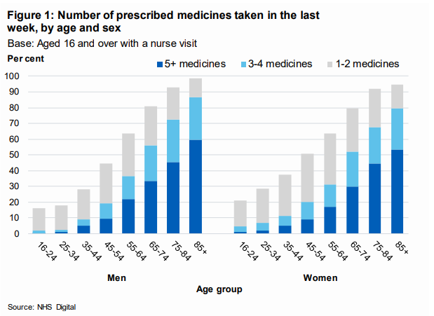
Some Facts about Medicines
48% of adults take at least one prescribed medicine and 24% take three or more medicines, not including contraception or nicotine replacement therapy.
The percentage of people taking prescribed medicines increases with age - more than 90% of those aged 75 or older, take a prescribed medicine compared with 19% of young adults aged 16 to 24
Many people taking 5 or more medicines per day feel overburdened by their treatment
References: NHS Digital and Office of National Statistics (2017), Health Survey for England 2016, https://files.digital.nhs.uk/pdf/3/c/hse2016-pres-med.pdf
Notes:
Most common intervention The World Medicines Situation: Medicines Prices, Availability and Affordability, World Health Organisation, https://www.who.int/medicines/areas/policy/ world_medicines_situation/WMS_ch6_wPricing_v6.pdf
Around half of all adults take a prescribed medicine. In 2015/16 48% of adults had taken at least one prescribed medicine (not including contraception or nicotine replacement therapy) in the last week. This increased with age from 19% of young adults aged 16 to 24 to more than 90% of those aged 75 and over. 24% of adults were taking three or more medicines..NHS Digital and Office of National Statistics (2017), Health Survey for England 2016, https://files.digital.nhs.uk/pdf/3/c/hse2016-pres-med.pdf
NHS England, Medicines Value Programme, https://www.england.nhs.uk/medicines-2/value-programme/
Between 5 to 10 per cent of all hospital admissions are medicines related and around two-thirds of these admissions are preventable; Systemic review on drug related hospital admissions – A pubmed based search - PMC (nih.gov)
30 to 50 per cent of the medicines prescribed for long-term conditions are not being taken as intended (World Health Organisation – 2003) https://iris.who.int/bitstream/handle/10665/42682/9241545992.pdf

Slide 26
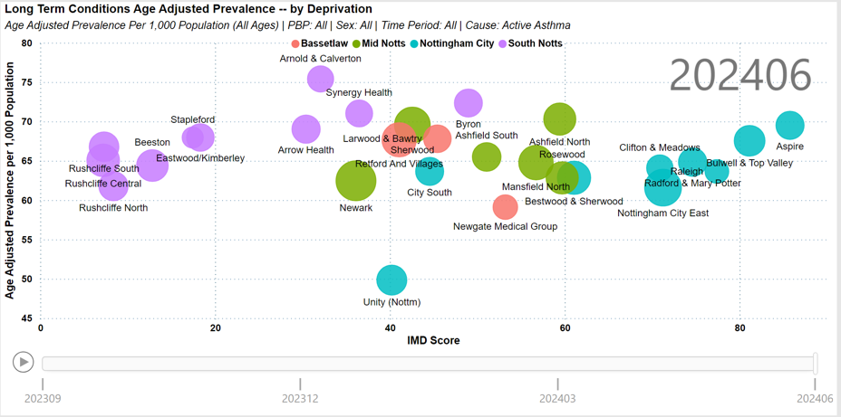
Some Facts about Medicines
People with long term conditions are more likely to live in more deprived communities within our ICS
20% of people living in Nottingham and Nottinghamshire have been diagnosed with one long term condition
16% have two or more long term conditions (multimorbidity)
Indices of Multiple Deprivation (IMD) Score
SAIU Portal, PHM Outcomes Dashboard,
The World Health Organisation estimate that 30- 50% of the medicines prescribed for long term conditions are not being taken as intended
Studies have found that between 5 to 10 per cent of all hospital admissions are medicines related and around two-thirds of these admissions are preventable
References: NIHR Multiple long-term conditions: How to reduce medications (nihr.ac.uk)
(World Health Organisation – 2003) https://iris.who.int/bitstream/handle/10665/42682/9241545992.pdf
Notes:
Between 5 to 10 per cent of all hospital admissions are medicines related and around two-thirds of these admissions are preventable; Systemic review on drug related hospital admissions – A pubmed based search - PMC (nih.gov)
30 to 50 per cent of the medicines prescribed for long-term conditions are not being taken as intended (World Health Organisation – 2003) https://iris.who.int/bitstream/handle/10665/42682/9241545992.pdf

Slide 27
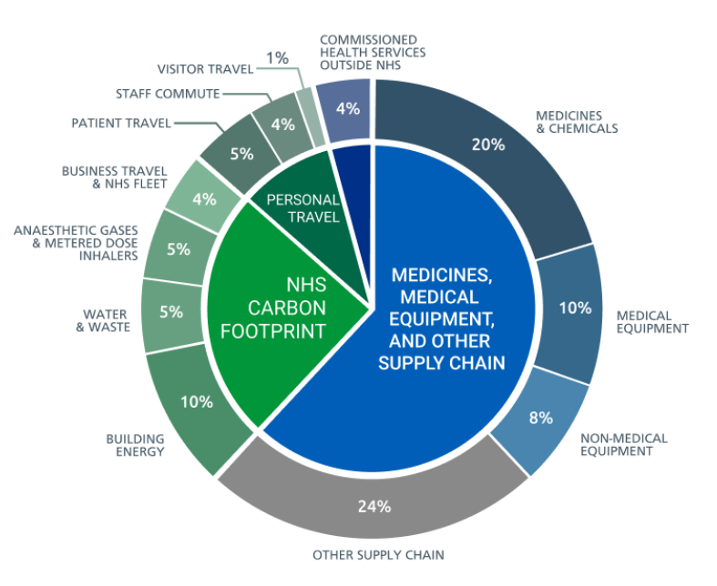
Some Facts about Medicines
Medicines use in the NHS equates to 1% of the whole of the UK’s carbon footprint
Medicines represent the second highest proportion of NHS spend, worth £18.5 billion in England in the 2022 to 2023 financial year.
25% of the NHS’s carbon footprint is medicines related
(Medicines (20%), Anaesthetic Gases and Metered Dose Inhalers – 5%)
Medicines that are disposed of incorrectly, increase the risk of environmental harm and can cause long-term impacts on ecosystems
Sources of carbon emissions by proportion of NHS Carbon Footprint
References: https://www.england.nhs.uk/greenernhs/wp-content/uploads/sites/51/2020/10/delivering-a-net-zero-national-health-service.pdf
NHS launches latest report on prescribing costs | NHS Business Services News (nhsbsa.nhs.uk)
Systemic review on drug related hospital admissions – A pubmed based search - PMC (nih.gov)

